Slide 1

Three-Dimensional Box Topology Optimization with constrained space
Literature Review

Slide 2
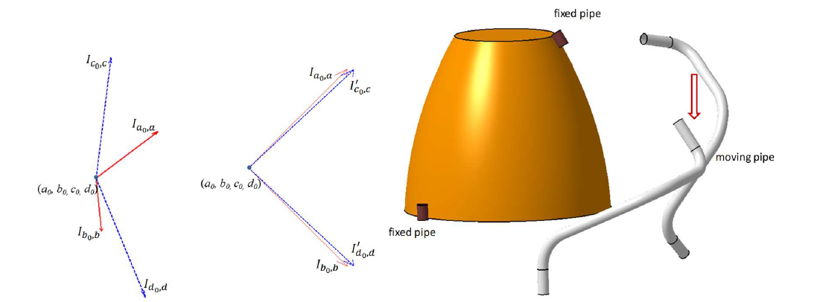
1st Paper: 3D line matching model and optimization for rigid pipeline assembly
Highlights:
Line matching: Matching the axis lines of cylinders using an objective function that is the sum on line orientations and locations.
Rotation matrix and Translation vector: Use rotation matrix to minimize angular disparity between axis and translation vector to make coincident origins for both geometries.
Pin Li and Zongbao Shen 2019 IOP Conf. Ser.: Earth Environ. Sci. 384 012104

Slide 3
2nd Paper: Topology Optimization of Multicomponent Structures
Highlights:
Multi-objective genetic Algorithms:
Define design variables(elements, joints), define constraints and define objective functions(which to maximize and minimize)
Create a population of solutions(chromosomes) and rank them according to the value of the objective function, saving the ones that show optimal values.
Select two chromosomes and crossover them. Afterwards, mutate the new chromosomes with a certain probability value. Evaluate the new chromosomes and update the population.
Genetic algorithms allow to tackle optimization problems with many objectives and constraints and generate optimal solution sets.

Slide 4
Our Case: Three-Dimensional Box Topology Optimization with constrained space
For this problem, we consider the line matching tool as well as the use of genetic algorithms as a viable way of solving the problem.
Inputs: Volume space, geometries(STL files)
Output: Optimal arrangement of the position of each body.
Load the geometries in the assembly space
Match the axis of the gearbox and output and fixed their position.
Define Constraints(bodies inside assembly space, no collisions)
Define objective functions(minimize distance between bodies)
Create a set of optimal configurations with the use of genetic algorithms, choosing the adequate values for crossover and mutation.

Slide 5
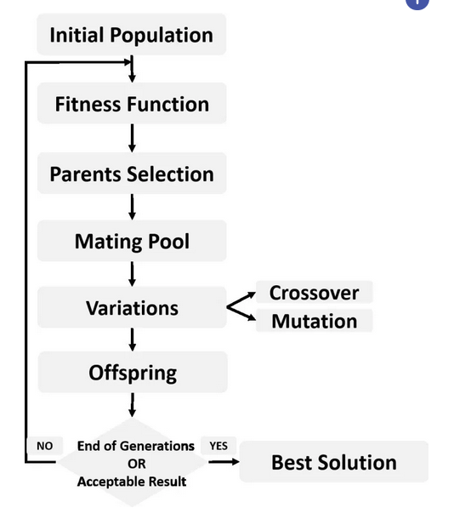
Genetic Algorithm
Define Constraints: No collisions, everything inside assembly space.
Initial population: Random position of each component, respecting the constraints.
Fitness function: Minimization of the distance between of components.

